Slide 1
Digital Communication Project Presentation
By: Debanjali Saha - 1810110059

Slide 2
Literature Review
Main IEEE paper: Uniform Linear Arrays With Optimized Inter-Element Spacing for Line-Of-Sight Massive MIMO
References reviewed:
“Noncooperative cellular wireless with unlimited numbers of base station antennas”
“Massive MIMO for next generation wireless systems”
“Massive MIMO with max-min power control in line-of-sight propagation environment”
“Linear precoding performance in measured very-large MIMO channels”
“An improved dropping algorithm for line-of-sight massive MIMO with max-min power control”
“An improved dropping algorithm for Line-of-Sight massive MIMO with Tomlinson–Harashima precoding”
“Does a large array aperture pay off in line-of-sight massive MIMO?”
“Per antenna power distribution of a zero-forcing beamformed ULA in pure LOS MU-MIMO”
“Antenna arrays for line-of-sight massive MIMO: Half wavelength is not enough”
“Array configuration effect on the spatial correlation of MU-MIMO channels in NLoS environments”
“Aspects of favorable propagation in massive MIMO”

Slide 3
IEEE Paper understanding
Title: Uniform Linear Arrays with Optimized Inter-Element Spacing for Line-of-Sight Massive MIMO
Keywords to be understood from title:
Massive MIMO
Line-of-sight propagation
Inter-Element Spacing in antenna array
Uniform Linear Arrays
Next set of keywords that appeared in the paper, to be understood:
Max-min power control
Sum-rate (bits/channel)
Zero-forcing precoder
Beamforming

Slide 4
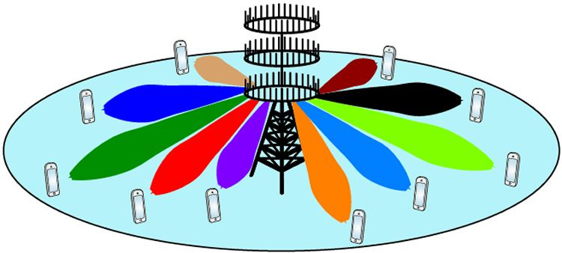
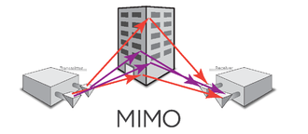
MIMO and Massive MIMO
MIMO stands for ‘Multiple-Input Multiple-Output’.
In simple words of my understanding, it can be said to be “A wireless network that allows the transmitting and receiving of multiple data signals simultaneously over the same radio channel.”
MIMO exploits multipath propagation to multiply link capacity.
Massive MIMO, is an extension of MIMO, which essentially groups together antennas at the transmitter and receiver to provide better throughput and better spectrum efficiency.

Slide 5
Throughput and Spectrum Efficiency
Throughput
Throughput or network throughput is the rate of successful message delivery over a communication channel. The data these messages belong to may be delivered over a physical or logical link, or it can pass through a certain network node. Throughput is usually measured in bits per second (bit/s or bps), and sometimes in data packets per second (p/s or pps) or data packets per time slot.
The system throughput or aggregate throughput is the sum of the data rates that are delivered to all terminals in a network.
Spectral Efficiency
Spectral efficiency, spectrum efficiency or bandwidth efficiency refers to the information rate that can be transmitted over a given bandwidth in a specific communication system. It is a measure of how efficiently a limited frequency spectrum is utilized by the physical layer protocol, and sometimes by the medium access control (the channel access protocol).
Example: A system uses channel bandwidth as 2 MHz and it can support a raw data rate of 15 Mbps, assuming 2 Mbps as overhead then net date rate will be as 13 Mbps, then its spectrum efficient can be calculated as follows: Spectral efficiency= 13 x 10^6 / 2 x 10^6 = 6.5 bits/second/Hz.

Slide 6
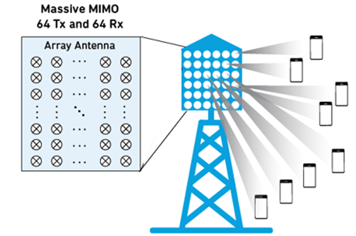
Massive MIMO example
Standard MIMO networks tend to use two or four antennas. Massive MIMO, on the other hand, is a MIMO system with an especially high number of antennas. There is no set figure for what constitutes a Massive MIMO set-up, but the description tends to be applied to systems with tens or even hundreds of antennas.
For example: Huawei, ZTE, and Facebook have demonstrated Massive MIMO systems with as many as 96 to 128 antennas. Ericsson’s AIR 6468, which the company claims is "the world's first 5G NR radio", uses 64 transmit and 64 receive antennas.

Slide 7
Why use massive MIMO?
Moving from MIMO to massive MIMO, according to IEEE paper titled ‘Massive MIMO for next generation wireless systems’, extra antennas help by:
focusing energy into ever smaller regions of space to bring huge improvements in throughput and radiated energy efficiency
cheaper parts
lower latency
simplification of the MAC layer, and robustness against intentional jamming
Advantages of a MIMO network over a regular one:
It can multiply the capacity of a wireless connection without requiring more spectrum and reports point to considerable capacity improvements, and could potentially yield as much as a 50-fold increase in future.
The more antennas the transmitter/receiver is equipped with, the more the possible signal paths and the better the performance in terms of data rate and link reliability.
Massive MIMO network is more responsive to devices transmitting in higher frequency bands, which will improve coverage. In particular, this will have considerable benefits for obtaining a strong signal indoors (though 5G’s higher frequencies will have their own issues in this regard).
The greater number of antennas in a Massive MIMO network will also make it far more resistant to interference and intentional jamming than current systems that only utilise a handful of antennas.

Slide 8
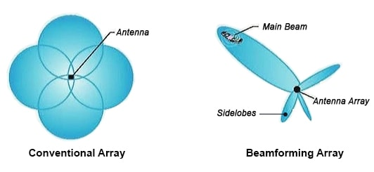
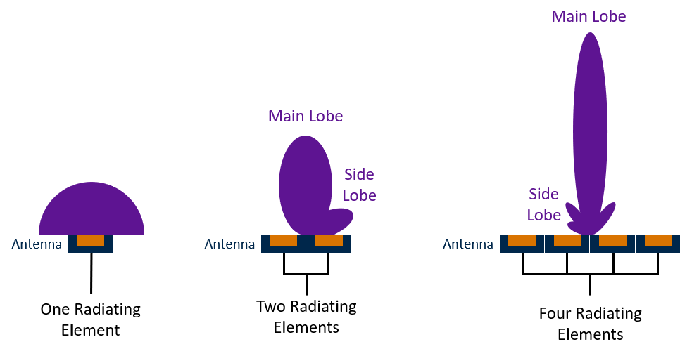
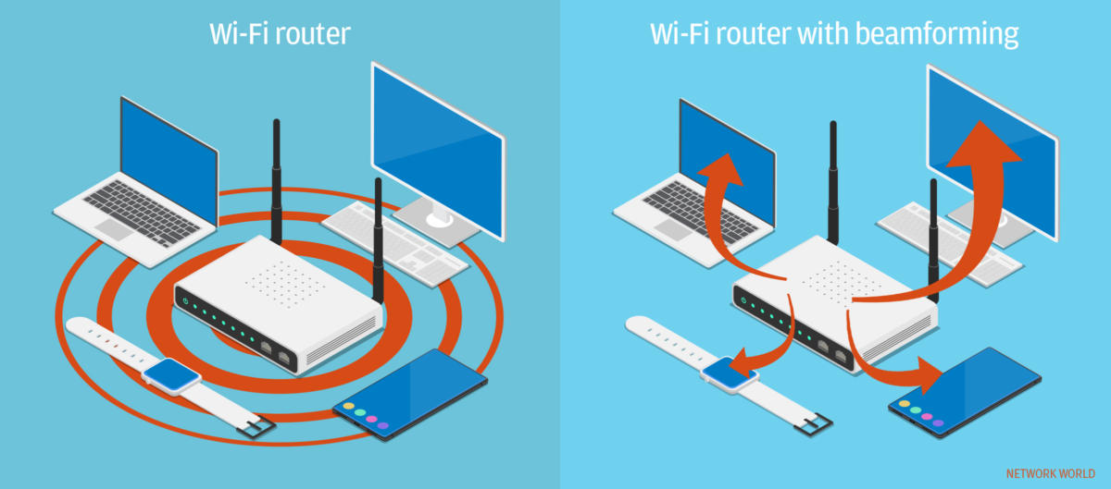
Beamforming
Beamforming or spatial filtering is a signal processing technique used in sensor arrays for directional signal transmission or reception. This is achieved by combining elements in an antenna array in such a way that signals at particular angles experience constructive interference while others experience destructive interference.
Beamforming can be used for radio or sound waves.

Slide 9
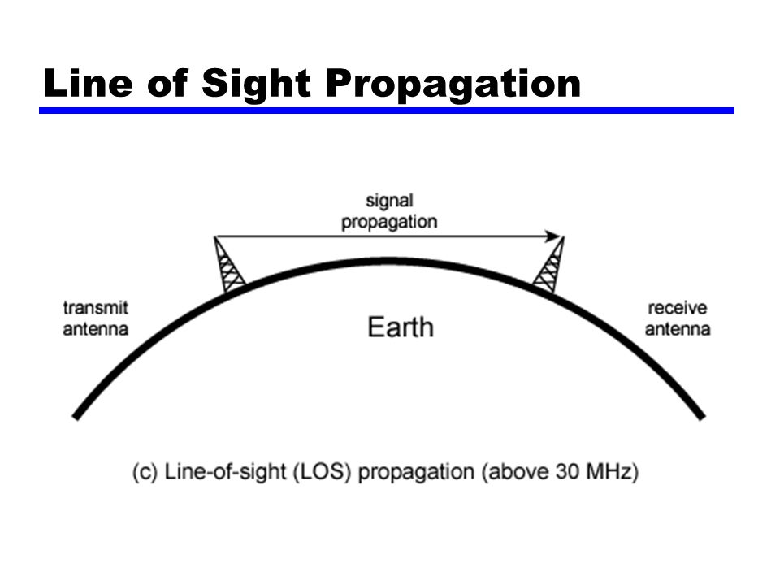
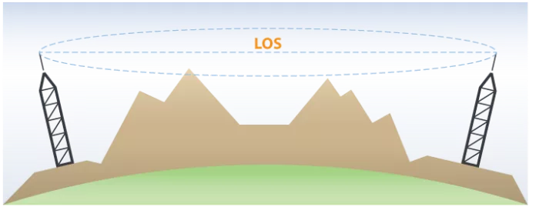
Line-of-sight propagation
Line-of-sight propagation is a characteristic of electromagnetic radiation which means waves travel in a direct path from the source to the receiver. Electromagnetic transmission includes light emissions traveling in a straight line. The rays or waves may be diffracted, refracted, reflected, or absorbed by the atmosphere and obstructions with material and generally cannot travel over the horizon or behind obstacles.
Line of sight (LoS) is a type of propagation that can transmit and receive data only where transmit and receive stations are in view of each other without any sort of an obstacle between them. FM radio, microwave and satellite transmission are examples of line-of-sight communication.

Slide 10
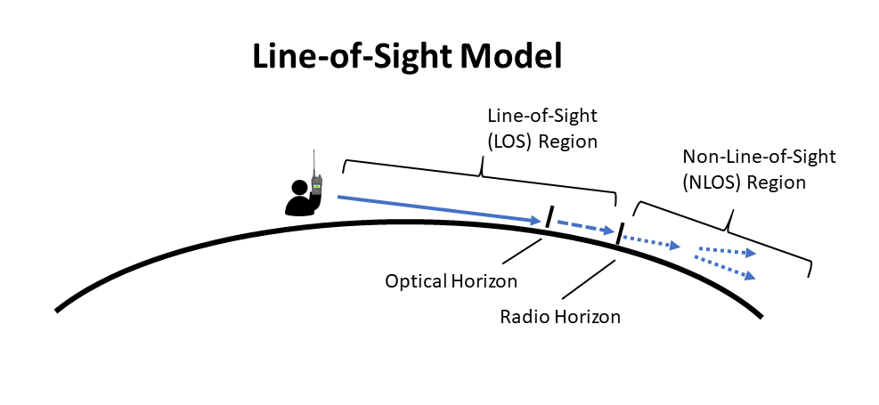
Non Line-of-sight
In contrast to line-of-sight propagation, at low frequency (below approximately 3 MHz) due to diffraction, radio waves can travel as ground waves, which follow the contour of the Earth called Non-Line-of-sight propagation. This enables AM radio stations to transmit beyond the horizon. Additionally, frequencies in the shortwave bands between approximately 1 and 30 MHz, can be refracted back to Earth by the ionosphere, called skywave or "skip" propagation, thus giving radio transmissions in this range a potentially global reach.
At frequencies above 30 MHz (VHF and higher) and in lower levels of the atmosphere, neither of these effects are significant. Thus, any obstruction between the transmitting antenna (transmitter) and the receiving antenna (receiver) will block the signal, just like the light that the eye may sense.
Therefore, since the ability to visually see a transmitting antenna (disregarding the limitations of the eye's resolution) roughly corresponds to the ability to receive a radio signal from it, the propagation characteristic at these frequencies is called "line-of-sight". The farthest possible point of propagation is referred to as the "radio horizon".

Slide 11
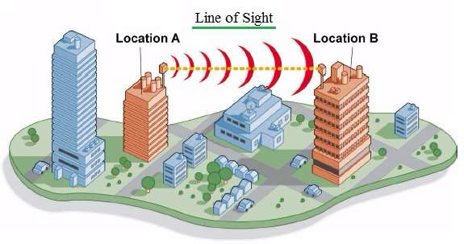
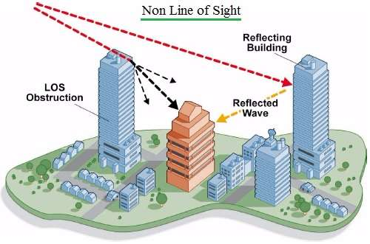
LOS vs Non-LOS
In practice, the propagation characteristics of these radio waves vary substantially depending on the exact frequency and the strength of the transmitted signal (a function of both the transmitter and the antenna characteristics). Broadcast FM radio, at comparatively low frequencies of around 100 MHz, are less affected by the presence of buildings and forests.

Slide 12
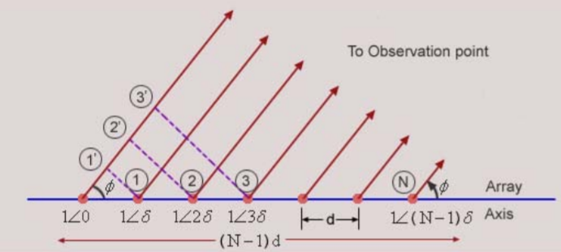
Uniform Linear Arrays and Inter-Element Spacing (δ)
Uniform Linear Array
An antenna array consists of identical antenna elements with identical orientation distributed in space. The individual antennas radiate and their radiation is coherently added in space to form the antenna beam. For a linear array, the antennas are placed along a line called the Axis of the array. The antenna elements in general could have arbitrary spacing between them and could be excited with different complex currents.
In a uniform array the antennas are equi-spaced and are excited with uniform current with constant progressive phase shift (phase shift between adjacent antenna elements) as shown in Fig. Let the array have N elements and let the antennas be isotropic (this condition will be relaxed later). All the antennas are excited with equal amplitude currents. Let us define the following for the array.
Inter-element spacing
It is the spacing between any two adjacent elements of the array.
δ
δ

Slide 13
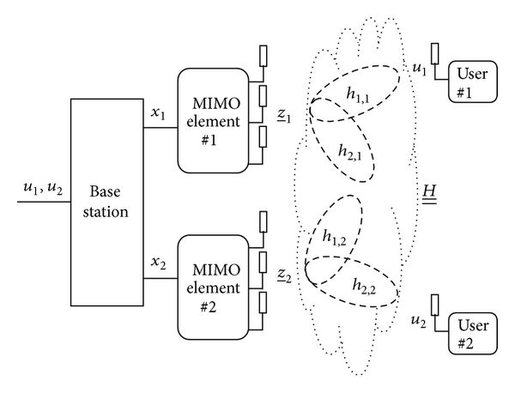
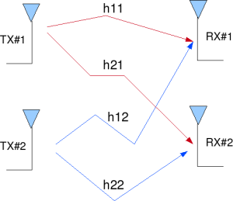
Zero-forcing precoder
Zero-forcing (or null-steering) precoding is a method of spatial signal processing by which a multiple antenna transmitter can null the multiuser interference in a multi-user MIMO wireless communication system. It is a linear precoder that maximizes the output SNR. It uses its antennas to actively cancel the interfering streams at a particular client.

Slide 14
Objective
Goal: For a given Uniform Linear Array with an arbitrary inter-element spacing, the probability that the correlation among the channel vectors of two users being above a threshold value is derived and an optimized inter-element spacing is proposed with this probability being minimized.
Assumption:
Narrow-band communication system
Number of antennas is fixed = 64.
Results: By using the proposed Uniform Linear Array instead of conventional half-wavelength Uniform Linear Array , 5th percentile sum-rate for zero-forcing precoder is improved by 9.90 bits/channel use in the first scenario without dropping, and by 1.43 bits/channel use in the second scenario with dropping 1 user.
** To show the effectiveness of the proposed ULA, simulation results for two scenarios are given for a 64-antenna ULA that serves 6 single-antenna users.
Hence, it is a 64x6 massive MIMO.

Slide 15
Review of reference papers
Problem: In line-of-sight (LOS) massive MIMO, there is a non-negligible probability that the channel vectors of some users become highly correlated, which results in a non-favorable propagation environment. The high correlation leads to a reduction in the sum-rates of linear and nonlinear precoders. The reduction of the sum-rate due to the high correlation is considerable for LOS environments with max-min power control.
In addition, it is shown that when there is only one pair of highly correlated users, the signal to noise ratio with max-min power control will drop significantly.
Solution1: To deal with highly correlated scenarios in LOS environments with max-min power control dropping users could be an option. However, it is not desirable.
Solution2: To avoid dropping and improve the inter-user correlation, the aperture size can be increased to improve the angular resolution of the base station (BS) antenna array. By increasing the aperture size, the minimum resolvability angular resolution of the array, which is defined by the well-known Rayleigh’s criterion, is improved.
Hence, by employing an inter-element spacing (δ) larger than the conventional λ/2 (λ being wavelength) the angular resolution of an array with a fixed number of elements is enhanced.

Slide 16
Purpose of this IEEE Communications letter
Drawback of Solution2: The major drawback of increasing δ in the uniform linear arrays (ULAs) is the appearance of grating lobes (beamforming ambiguities). The grating lobes may cause a high correlation among the channel vectors of users with a large angular separation (not co-located users).
Solution for drawback: To avoid grating lobes, a maximum allowable δ, depending on the field-of-view (FOV), is proposed, where the increase in the aperture size is minimal for wide FOVs.
Increasing δ is reported beneficial in terms of spectral efficiency for a BS antenna array with a fixed number of antennas. A small LOS spectral efficiency improvement is also reported in by deploying ULAs with larger inter-element spacing.
However, since none of the other papers approached the problem analytically to compute the probability of correlated users in the absence or presence of grating lobes, this letter’s aim was to do so.

Slide 17
Aim
In this letter, a Uniform Linear Array for Line-Of-Sight environments is proposed assuming a fixed number of omnidirectional antennas at the BS.
The probability that the correlation among the channel vectors of two users being above a threshold for a Uniform Linear Array with an arbitrary inter-element spacing was derived. The inter-element spacing of the proposed Uniform Linear Array is the one for which this probability is minimized.
The proposed Uniform Linear Array is optimized for the case when there are only two users. For more users, simulation results are presented for two different scenarios, to show the effectiveness of the proposed array compared to conventional half-wavelength Uniform Linear Array with a known linear precoder, i.e., zero-forcing (ZF).

Slide 18
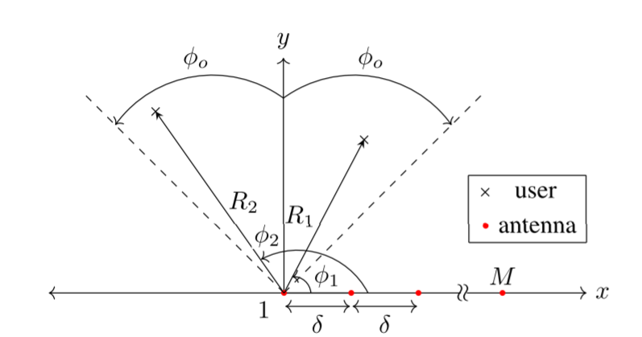

System Model
We consider a BS equipped with a ULA of M antennas located on the x-axis.
Two users are assumed to be in the x-y plane
R1 and R2: distance from the users to the first element of the array
φ1 and φ2: angles of the users
Assumption: φ1 and φ2 are independent random variables that are uniformly distributed in a FoV of Φl ∈ (π/2 − Φo, π/2 + Φo), where
Φo ∈ (0, π/2).
The channel between user l (l ∈ {1, 2}) and antenna m (m ∈ {1, 2,...,M}) is modeled as:
where
βl =large-scale fading for user l
k =wavenumber
δ = inter-element spacing of ULA. (Typically, δ is assumed to be λ/2)
Using (1), the channel vector h_{l} = (hl₁, hl₂,...,hl_{M})^{T} is found.
-----(1)

Slide 19
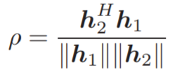
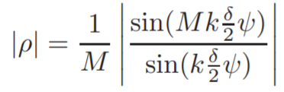

System Model
The spatial correlation between the channel vectors h1 and h2 is given by:
This is the inner-product of normalized h1 and h2 for a given coherence interval.
By replacing the elements of the channel vectors h1 and h2 using (1), in (2), |ρ| is found by:
where ψ = cos(Φ1)−cos(Φ2). Using (3), |ρ| is expressed as a function of ψ with the inter-element spacing of δ as follows:
Note f_{δ}(ψ) is periodic with period T = λ/δ
-----(2)
-----(3)
-----(4)

Slide 20
System Model
For a given realization of a channel of two users, assume that the angular separation of the users is ψ = Δ. One can find the inter-element spacing δ1 such that the users become orthogonal, i.e., |ρ| = f_{δ1} (Δ) = 0.
But why take probabilities and not the actual inter-element spacing?
Suppose the users move and the angular separation of the users becomes Δ’ ≠Δ. In this case, another inter-element spacing δ2 ≠ δ1 has to be used to make the users orthogonal.
However, changing the inter-element spacing for each realization of users is not practical.
Therefore, a probabilistic approach is required to find the best inter-element spacing δ* for which a small |ρ| is achieved with a high probability. In other words, the best inter-element spacing is the one that has the minimum probability that |ρ| becomes larger than a given threshold ρo.

Slide 21

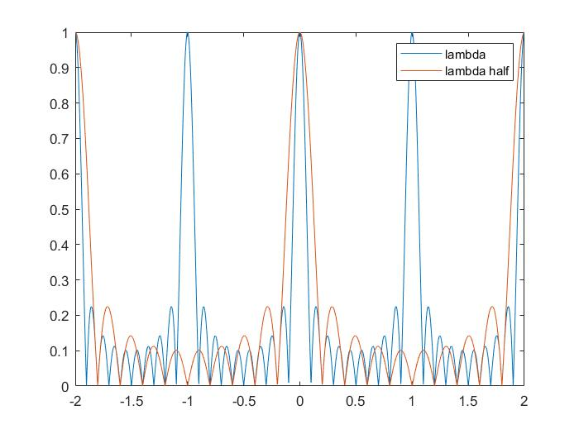
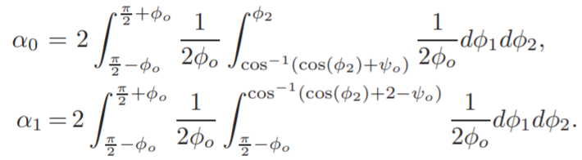
Probability Analysis
Definition 1: The probability that a pair of users with the spatial correlation of ρ become correlated with a given ρo, is denoted by p, and defined as:
Then p for ULAs with δ = λ/2 and then for ULAs with δ > λ/2 when there are only two users were found.
ULAs With δ = λ/2
|ρ| = f_{λ/2}(ψ) is shown for a ULA of M = 10 antennas.
If ψo is chosen as in Fig. 2, we can derive p as follows using the periodicity
of fλ/2(ψ) (T = 2):

Slide 22
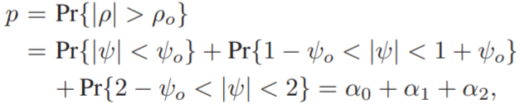
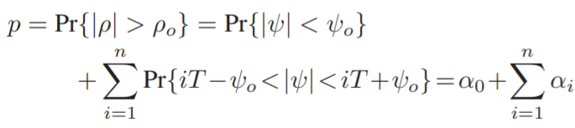
Probability Analysis
B. ULAs With δ > λ/2
First, find p for a ULA with δ = λ. Then, we give an expression for ULAs with any δ > λ/2.
In Fig. 3, |ρ| = fλ(ψ) is shown for a ULA of M = 10 antennas. The shaded areas show when user 1 and user 2 become correlated with a given ρo.
The probability p is found by:
For a ULA with δ > λ/2, p for a given ρo is found by:
where n is the number of areas where ψ > 0 and ρ>ρo excluding the area corresponds to α0. For instance, n = 2 for δ = λ. We numerically evaluate integrals to find α0 and αi to find p, same as the analysis done for λ/2.

Slide 23
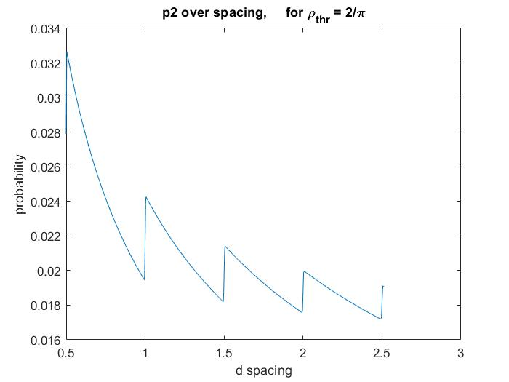
Probability Analysis
In the figure, p is shown as a function of δ/λ for: M = 64 for δ ≤ 2.5λ, for a FoV of (0, π).
δ shows the inter-element spacing with minimum p, and there are three local minima as shown by colored circles δn1 , δn2 , and δn3 . By increasing δ, p is continuously increasing and then decreasing with decaying behavior.
There are two reasons for explaining this behavior:
By increasing δ, the angular resolution of the array is improved which decreases p.
By increasing δ, the grating lobes (the peaks correspond to αi, i = 0, see Fig. 3) gradually appear in the FoV, which increases p.
Due to the first reason, p should decrease, and due to the second reason, p should increase. As can be seen, we see a more decrease in p, which shows that increasing the angular resolvability has a stronger effect on p than the grating lobes. Moreover, the effect of increasing the angular resolvability and the appearance of grating lobes is decaying as δ approaches 2.5λ. We further observe that in all the scenarios, p curves approach p = 1/M.

Slide 24
Probability Analysis
For a given M, we propose to use δ, which is the inter-element spacing with the minimum p.
To reduce the aperture size, one can use δni , i = 1, 2, 3 instead of δ*.
As stated earlier, this letter assumes a narrow-band communication system. However, the results in this plot can be used for multi sub-carriers systems.
By choosing an appropriate spacing for the center sub-carrier, one can make p smaller than a threshold for all the sub-carriers.

Slide 25
Simulation results
The performance of ULAs using δn1 and δ* for more number of users is compared.
To study the worst-case scenarios, the users are assumed to be at the cell-edge (no shadowing), which is assumed to be at the far-field of the array. We compare the arrays qualitatively and quantitatively as follows:
First, qualitatively, for a given ρo, we compare the probability that at least there is one correlated pair of users as a function of the number of users for the three arrays.
Second, quantitatively, we compare cumulative distribution function (CDF) of ZF sum-rates of the arrays.
To show the effectiveness of the proposed ULA compared to half-wavelength ULA, simulation results are shown for two cases for a known linear precoder, i.e., ZF.
The first is Probability vs K.
The second is Cumulative Distribution Function vs Achievable sum-rate(bits/channel).

Slide 26
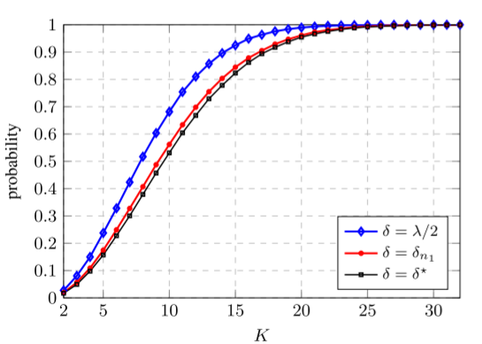
Simulation results
In the figure, for a ULA with M = 64 antennas, the probability that there is at least one pair of correlated users (ρo = 0.64) is shown as a function of the number of users K for δ = λ/2 (blue), δn1 (red), and δ* (black).
For a given number of users, the ULA with δ has a smaller probability compared to λ/2, which means it has a better ability to decorrelate the channel vectors of the users.
By using δn1 instead of δ*, we can reduce the aperture size, while the probability that there is at least one pair of correlated users is not that higher than that of δ*.

Slide 27
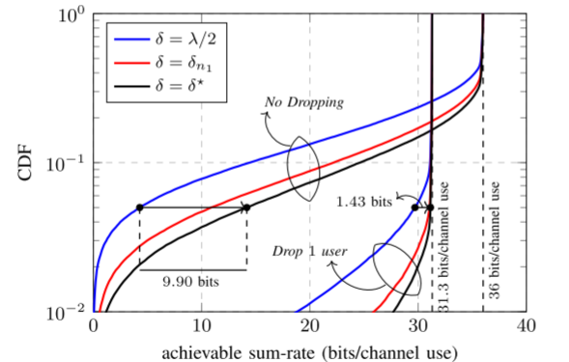
Simulation results
In the figure, the CDF of ZF sum-rate is shown for the arrays with K = 6 and M = 64 in two different scenarios, where 100K realizations of users’ locations are drawn for each scenario.
In the first scenario, no user is dropped (No Dropping), while in the second scenario one user is dropped (Drop 1 user) based on the dropping algorithm of the paper “Massive MIMO with max-min power control in line-of-sight propagation environment’’.

Slide 28
Simulation results
The transmit power at the BS is fixed and is the same in both scenarios such that in the favorable propagation (FP) (when the users are mutually orthogonal), a sum-rate of 36 bits/channel use is achieved in the first scenario, and a sum-rate of 31.3 bits/channel use is achieved in the second scenario. When no user is dropped, by employing the proposed array (black), the 5th percentile sum-rate is improved significantly (9.90 bits/channel use) compared to that of the ULA with δ = λ/2 (blue). This improvement becomes 1.43 bits/channel use when 1 user is dropped. By dropping 1 user, the 5th percentile ZF sum-rate of all the arrays is improved significantly, which shows it is necessary to drop 1 user.
To reduce the aperture size, the array with δn1 (red) can be used instead of δ with a loss in performance, i.e., 3.30 bits/channel use loss in No Dropping scenario and 0.09 bits/channel use in Drop 1 user scenario.

Slide 29
Conclusion
In this letter, probability analysis was used to find an improved uniform linear array for LOS massive MIMO. For the case of two users, the proposed ULA has the minimum probability that the correlation of the users being above a given threshold.
For more users, simulation results were presented for a known linear precoder, i.e., ZF to show the effectiveness of the proposed ULA compared to half-wavelength ULA.
THANK YOU!

